Slide 1
Module 2: Work with Microsoft Dataverse

Slide 2
Dataverse concepts
Tables
Processes and automation*
Security
* We discuss process and automation in depth later in the course

Slide 3

What is a relational database?

Slide 4
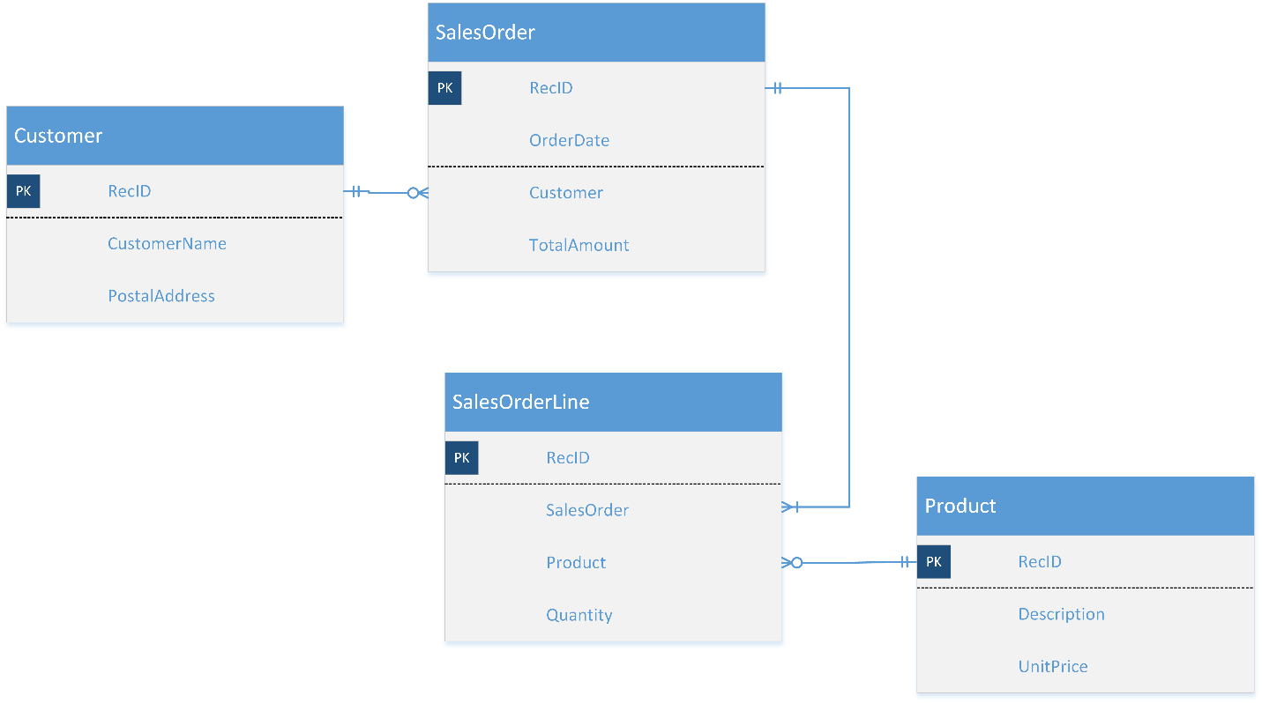

Data model overview
Data modeling
A process used to define and analyze data requirements needed to support the business processes
Definitions
Table: Container for data (entity)
Column: Container for a piece of data in a table (field)
Relationship: Construct defining an association between 2 tables
Metadata: Definitions for tables, columns, and relationships

Slide 5
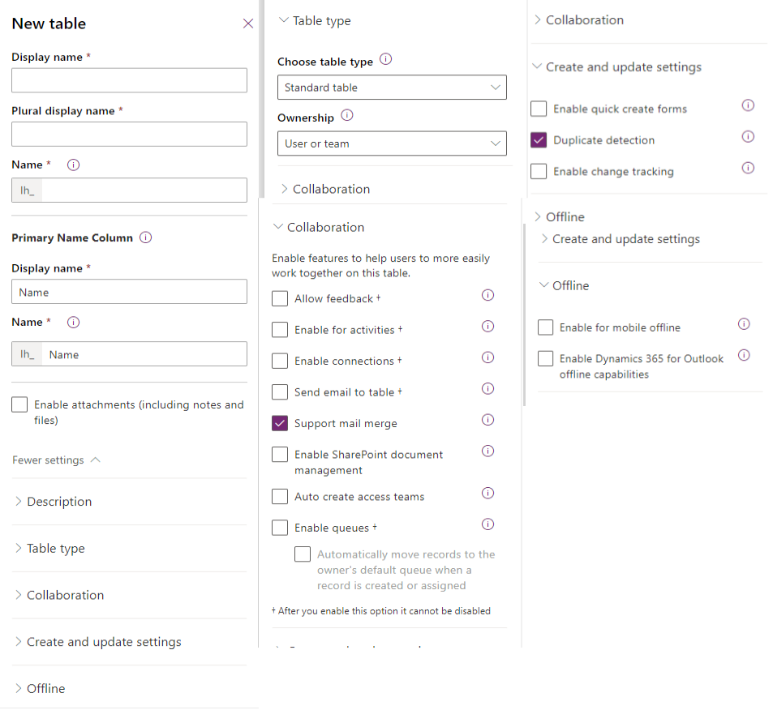
Other table options
Ownership
Activity tables
Areas that display this table
Process
Communication and collaboration
Data Services
Auditing
Outlook & Mobile
Help

Slide 6
Data Modeling Influencers
Security requirements
User experience
Data location and retention policies
Self service reporting needs
Roadmap
Existing systems
Localization
Balancing Influencers

Slide 7
When to use standard tables, and when to create new tables
Dataverse comes with a number of standard tables that support core business application capabilities.
To change the display name you can edit the table. You don't have to create a new table.
You can't delete standard tables, but you can hide them. To hide a standard table, change the security role privileges for your users to remove the Read privilege for that table. This will remove the table from most parts of the application.

Slide 8
Activity tables
An activity is used to track an interaction
They have time dimensions (start time, stop time, due date, and duration) that help define when the action occurred or will occur.
They have data (like a subject and description) that helps define the action that the activity represents.
They can be opened, canceled, or completed. Several sub-status values will be associated with the Completed status of an activity to clarify how the activity was completed.
All activities are accessed via the same security privileges, you cannot have different levels of access for different activity types
Appointment: A commitment representing a time interval that has start/end times and duration.
Email: An activity that's delivered by using email protocols.
Fax: An activity that tracks the call outcome and number of pages for a fax. The activity can optionally store an electronic copy of the document.
Letter: An activity that tracks the delivery of a letter. The activity can store an electronic copy of the letter.
Phone Call: An activity that tracks a telephone call.
Recurring Appointment: The master appointment of a recurring appointment series.
Task: A generic activity representing work that must be done.
Custom: Any custom activity that does not fit with the above out of the box activities

Slide 9
Columns in Microsoft Dataverse
Columns are a way to store a discrete piece of information within a row in a table.
Tip: Always use standard tables and columns when possible. You can rename a table if that makes the table more understandable in the context of your solution. Always review the list of standard tables and make sure a standard table will not meet your needs before you create a new table.

Slide 10
Column data types
Text
Currency
File
Choice
Multiple line text
Choices
Yes/No
Date and time
Status
Whole number
Lookup
Status Reason
Floating point number
Image
Unique Identifier
Decimal number
Calculated column
Customer

Slide 11
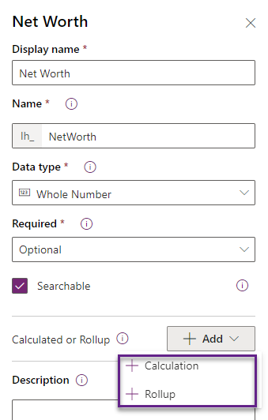
Calculated and rollup columns
Simple column:
Contains data not based on formula
Example: First name, birthday, or email address
Calculated column:
Contains calculations that use columns from the current table or related parent table
Example: Full name (= First name + last name)
Rollup column:
Contains an aggregate value computed from the rows related to that row, or a value computed over a hierarchy
Example: Potential revenue (= Sum of revenues of all open opportunities for a given account)

Slide 12
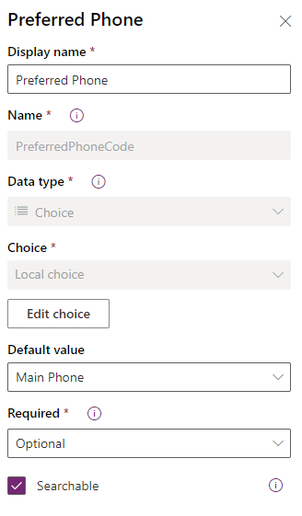
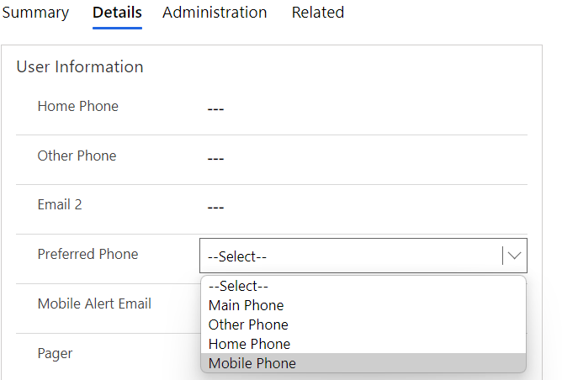
Define choice column
Choices provide an exact list of values that people can choose.

Slide 13
Auto numbering column
Auto number columns automatically generate alphanumeric strings whenever they are created.
String prefixed number - The most common auto number format is a simple string prefixed number.
For example, Contoso-1000, Contoso-1001, Contoso-1002, and so on.
Date prefixed number - Automatically incrementing number with a formatted date prefix.
For example, 2021-26-02-1000, 2021-27-02-1000, 2021-28-02-1000
Custom - For more advanced makers with specific use cases, you have the option to fully customize the desired format of an auto number column.

Slide 14
Alternate Keys
Tables can have up to 5 alternate keys
Index is created behind the scenes to enforce uniqueness
Great for use in retrieves and updates

Slide 15
Table relationships
Table relationships define the different ways table records can be associated with records from other tables or the same table.
One-to-many relationships: In a one-to-many (1:N) table relationship, many related table records are associated with a single primary table record in a parent/child relationship.
Many-to-many relationships: In a many-to-many (N:N) table relationship, many table records are associated with many other table records. Records that are related through N:N table relationships are considered peers.
When I delete a record, should any records that are related to that record also be deleted?
When I assign a record to a new owner, do I also have to assign all related records to the new owner?
How can I streamline the data entry process when I create a new related record in the context of an existing record?
How should people who view a record be able to view the related records?

Slide 16
Relationships overview
Represent relationships between real-world concepts
Example
A customer can have multiple associated sales orders
A sales order can have multiple associated products

Slide 17
Relationship types – 1:N
One record of a primary table
Venue
Zero, one or many records of a related table
Related table has a lookup column
Event 1
Event 2
Event 3
N:1 is a reverse 1:N relationships

Slide 18
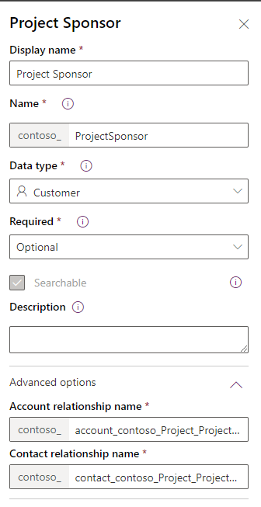
Relationship types – 1:N (Customer)
Used in cases when a lookup needs to allow for a relationship with more than one type of table
Example: “Customer” can look up to Account or Contact
Two 1:N relationships created

Slide 19
Relationship types – N:N
Events
Many-to-many (N:N) is symmetrical
Hidden intersect table created
Hidden intersect table
Two 1:N relationships
Intersect table cannot be customized:
Can be used by report designers and developers
Contacts

Slide 20
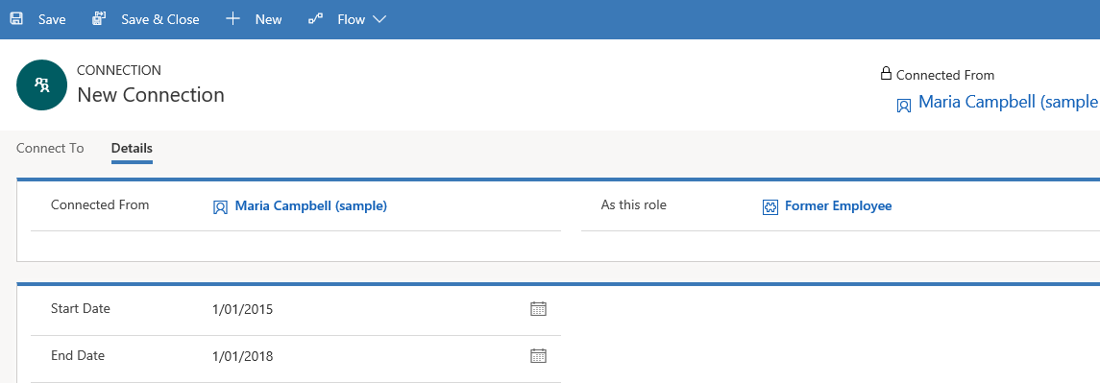
Relationship types – N:N (connections)
Defines a connection between table rows without creating a formal relationship
Connection roles:
Name
Connection role category
Description

Slide 21
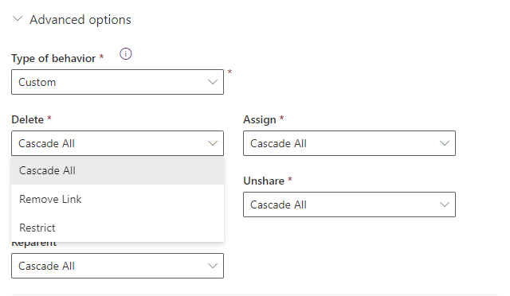
Relationship behaviors
Preserve data integrity
Rollup activity view
Parental relationships
Automate business processes

Slide 22
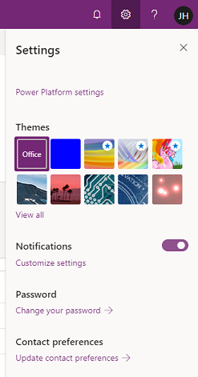
Configure administration settings
Configure in Microsoft Power Platform admin center
Microsoft Power Platform settings
Themes
Notifications
Password
Contact preferences

Slide 23

Demo

Slide 24
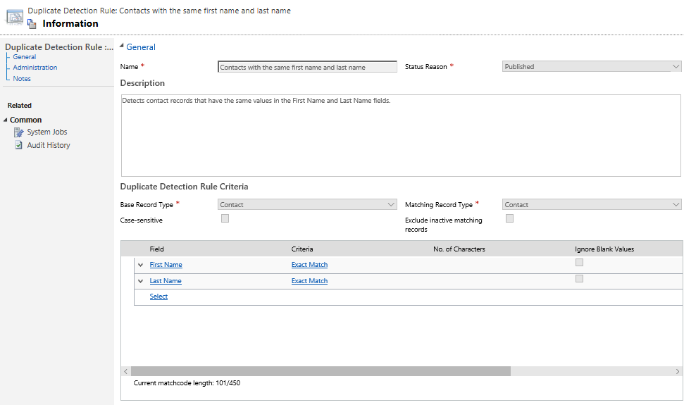
Configure duplicate detection settings
Keep data clean
Alert potential duplicates when creating or updating records in model-driven apps
Define rules to determine potential duplicate data

Slide 25
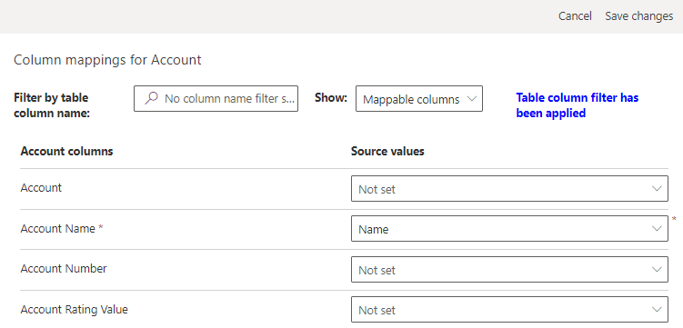
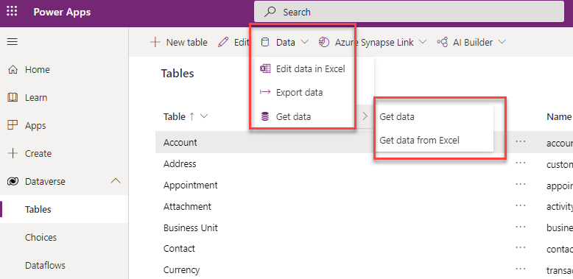
Import data
Get data from make.powerapps.com
Use import data wizard

Slide 26
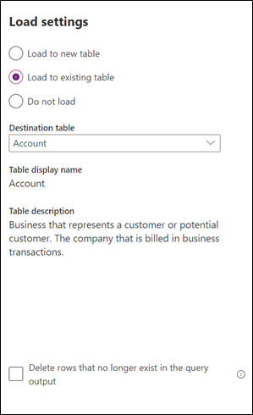
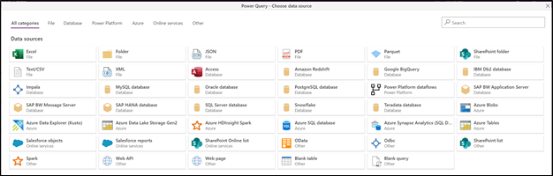
Use Dataflows
Allows you to transform and load data into Dataverse environments or Azure Data Lake Storage Gen 2
Define data connections, ETL logic, and destination

Slide 27
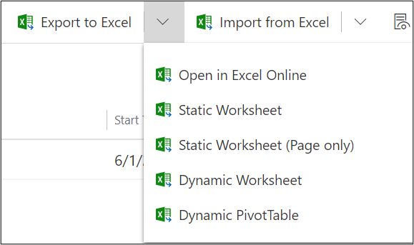
Export data
Export data from maker portal
Export to Excel
Use Power Automate
Use third-party tools and custom code

Slide 28
Module 2 practice labs
Lab 2.1: Create an app
Lab 2.2: Create tables and rows
Lab 2.3: Create relationships
Lab 2.4: Additional table options

Slide 29
Summary
Dataverse is a customizable relational database that supports many business uses
There are many built-in datatypes

Slide 30
close

